Slide 1
COST CONCEPTS
NAPINDER KAUR
Assistant Professor

Slide 2
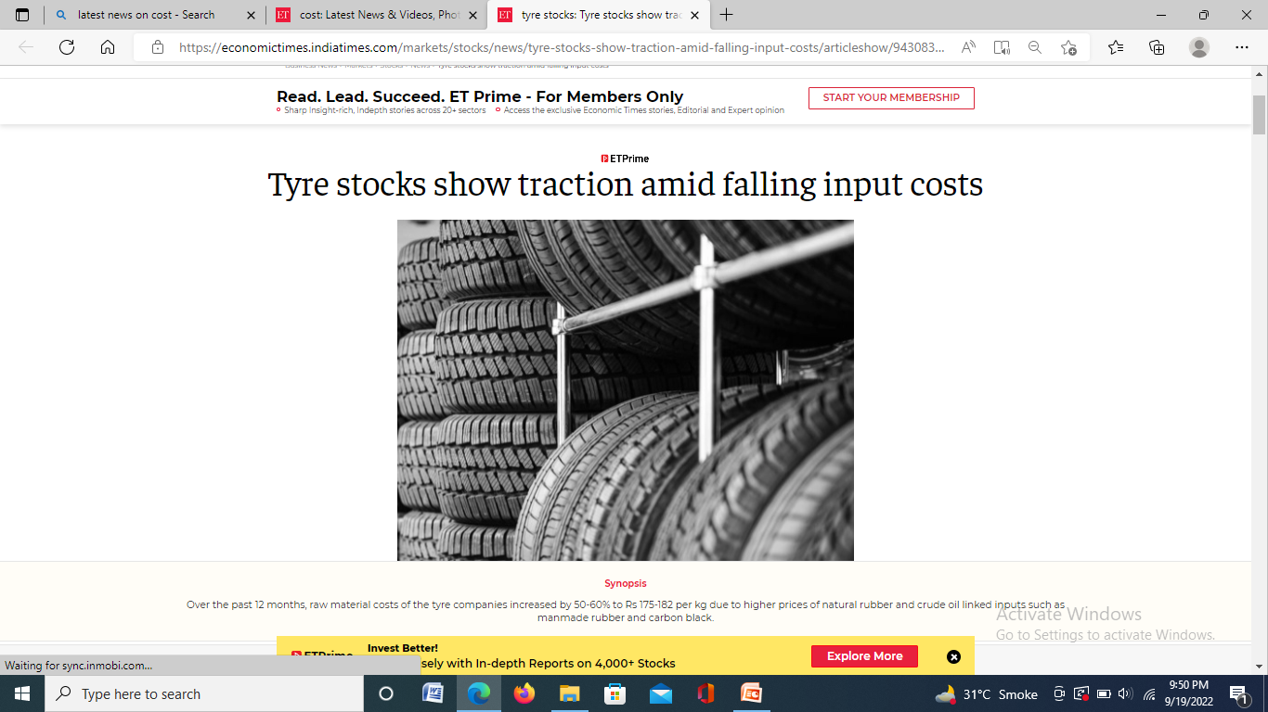
WHAT’S IN THE NEWS?

Slide 3
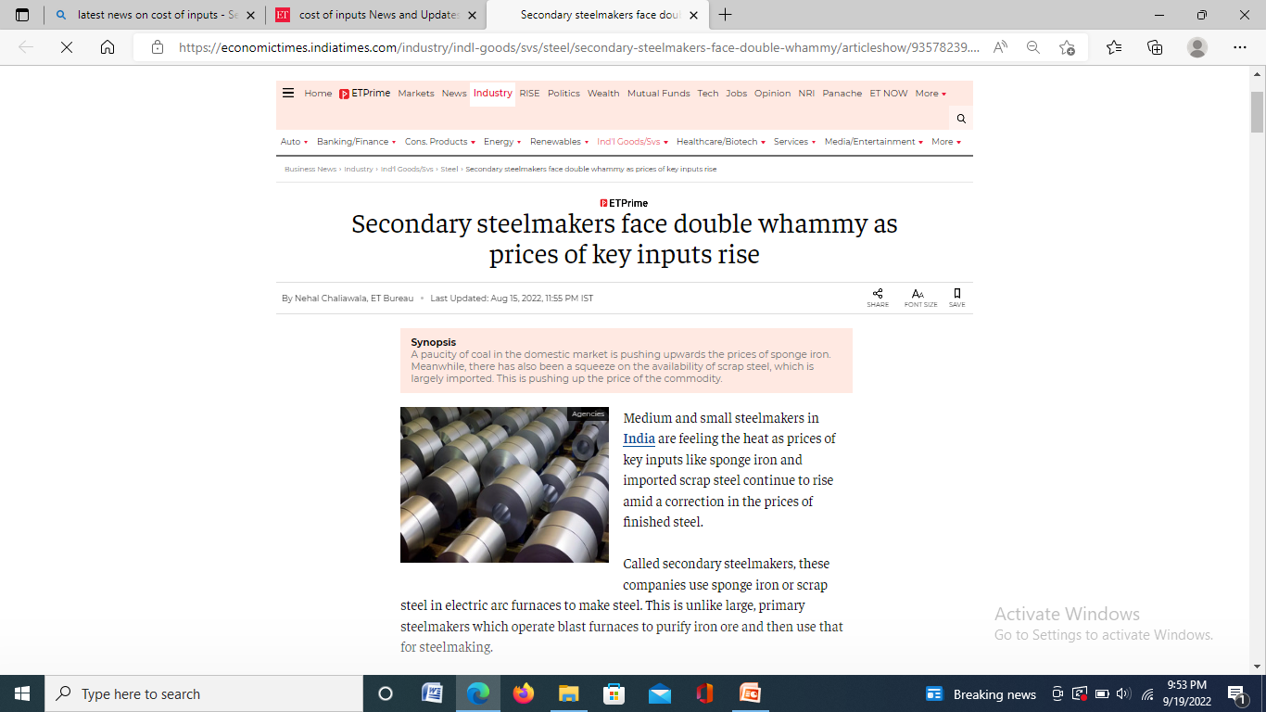
NEWS!

Slide 4
LEARNING OUTCOMES
After the lecture, you will be able to
Understand the meaning of cost in economic sense.
Explain different types of costs

Slide 5
COST
Cost is a sacrifice or forgoing that has occurred or has potential to occur in future, measured in monetary terms.

Slide 6
KINDS OF COSTS
Accounting cost
Real cost
Opportunity cost
Implicit cost
Explicit cost

Slide 7

…..CONTD.
Social cost

Slide 8

….contd.

Slide 9
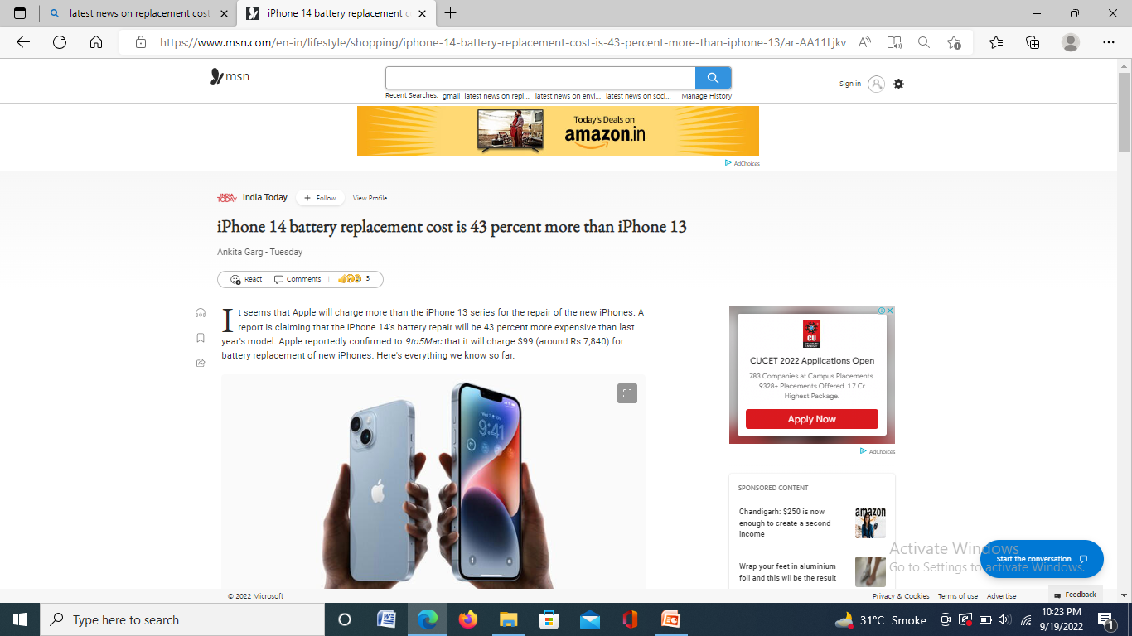
Replacement cost

Slide 10
Historic and future cost
Direct and indirect cost
Controllable and uncontrollable cost
Production and selling cost

Slide 11
COSTS IN SHORT RUN
Fixed costs
Variable costs
Total costs

Slide 12
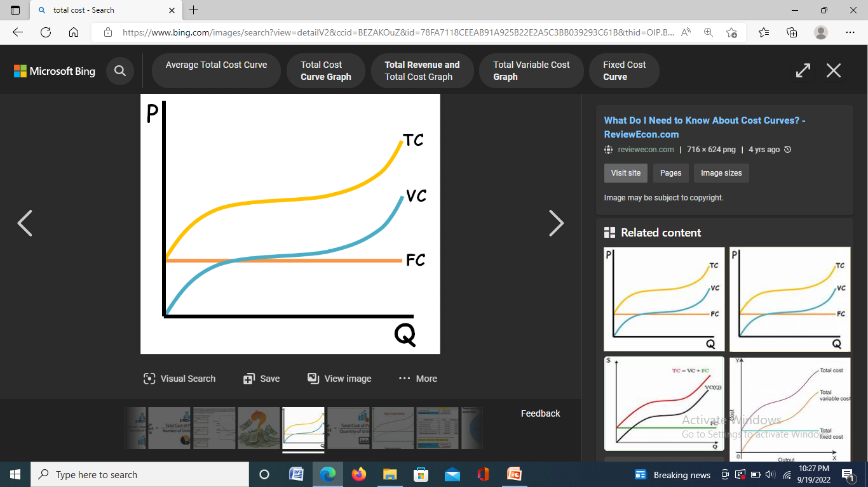
TOTAL COST

Slide 13
AVERAGE COST
Average fixed cost
Average variable cost
Average cost

Slide 14
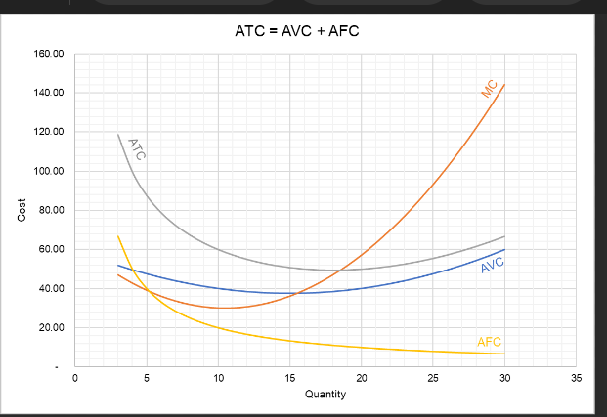
AVERAGE AND MARGINAL COST

Slide 15
ANALYTICAL CORNER
If a firm’s total cost function is given as
TC = 100 + 50Q – 11Q^2 + Q^3
Find MC, AC, AVC

Slide 16
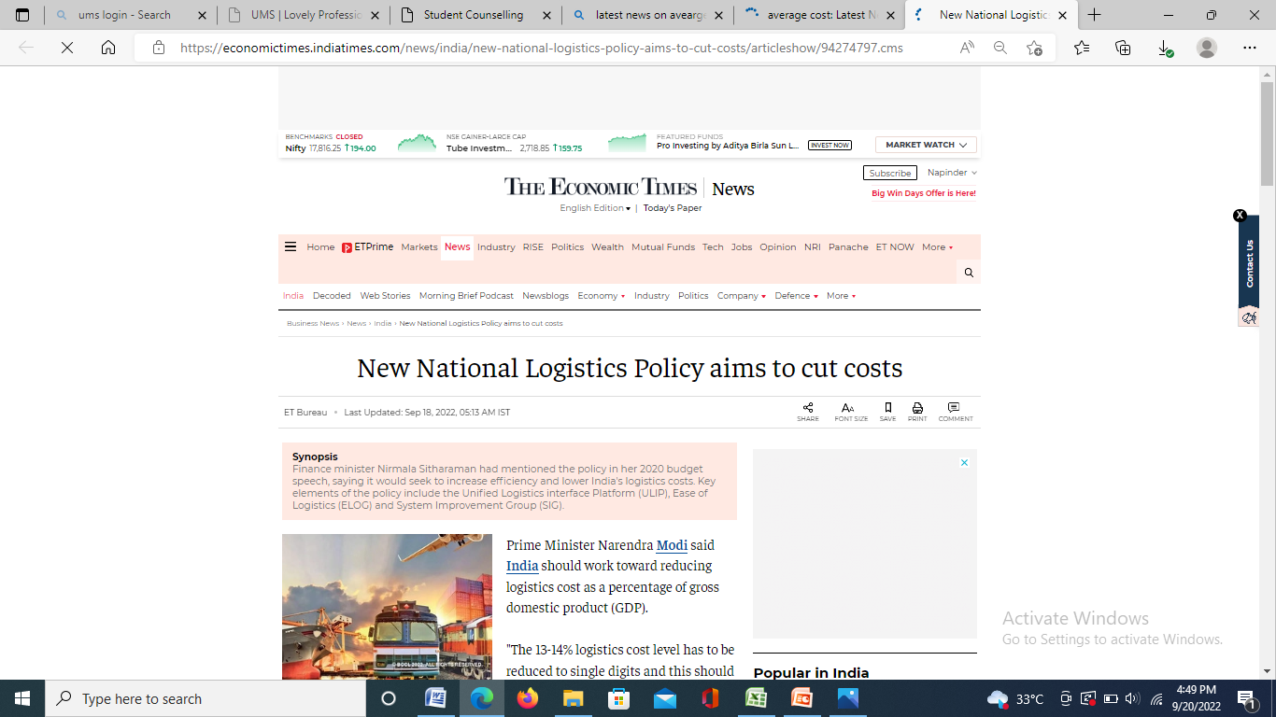
WHAT’S IN THE NEWS?

Slide 17
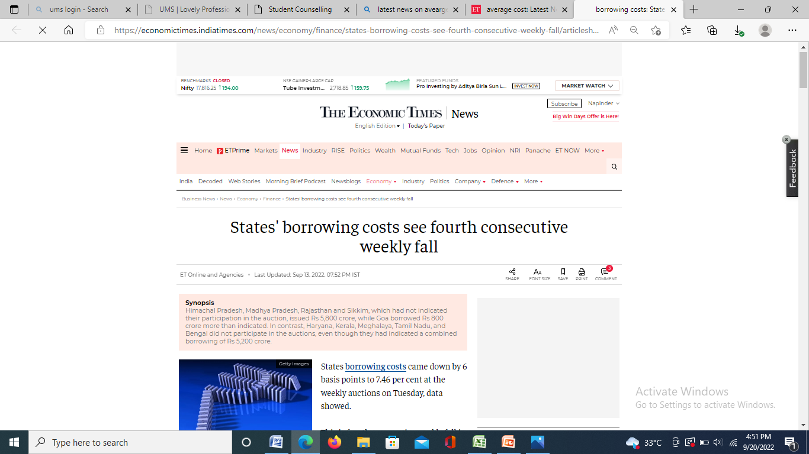
…CONTD.

